Slide 1
Lesson 7 – Homework review

Slide 2
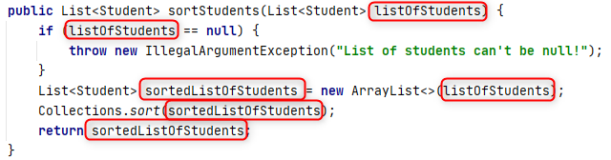
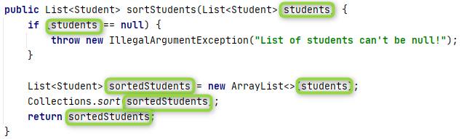
Do not Repeat Yourself

Slide 3
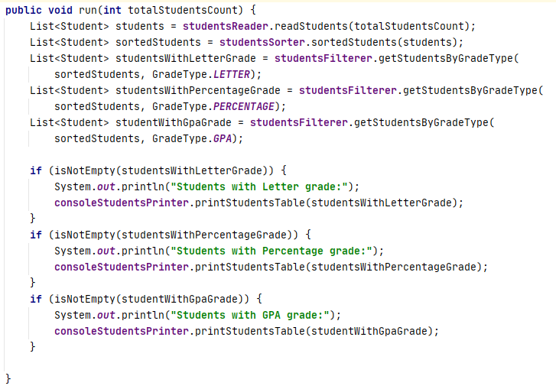
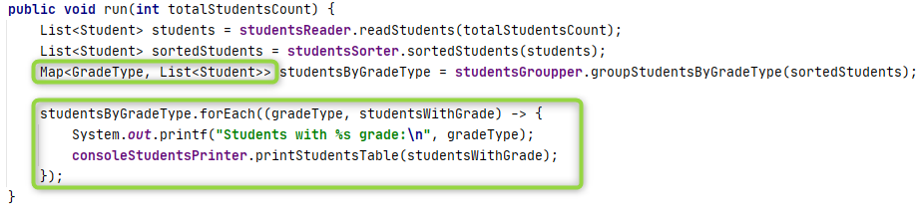
Do not Repeat Yourself

Slide 4


Follow Open-Close principle

Slide 5
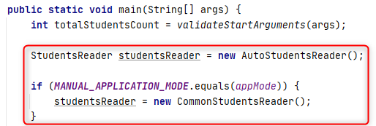
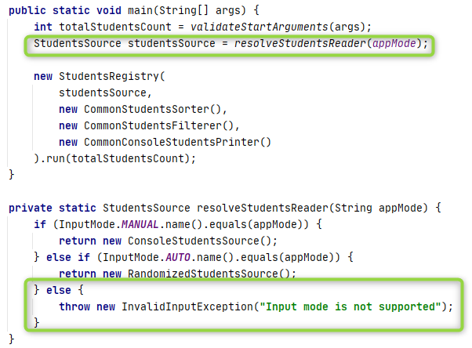
Follow Open-Close principle p1

Slide 6


Follow Open-Close principle p2

Slide 7
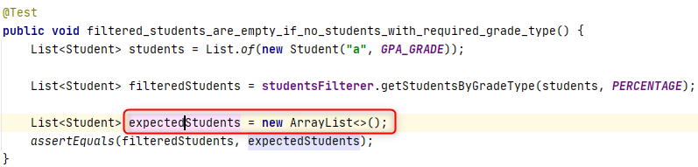
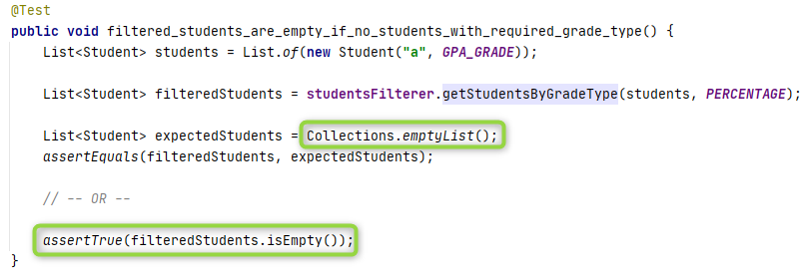
Optimize resources

Slide 8
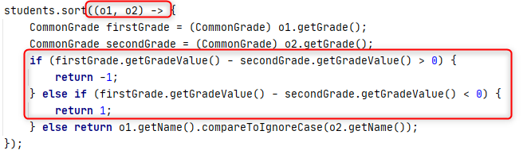
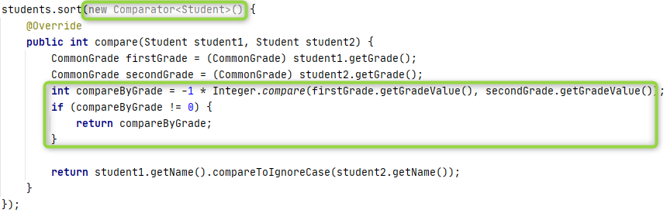
Type overflow

Slide 9
Thanks!
Any Questions?
Or find us in Slack:
@Yaroslav Brahinets
@Vasya Rudas

